Slide 1
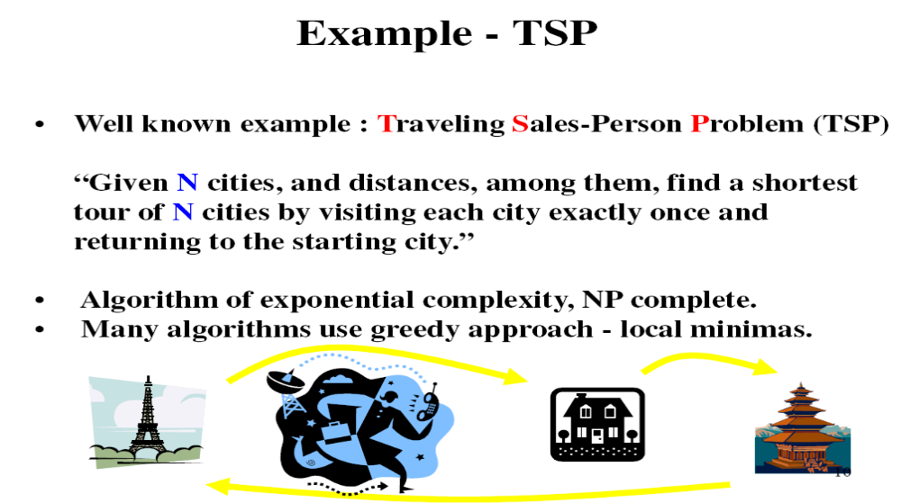
Assignment I
TSP with Simulated Annealing

Slide 2
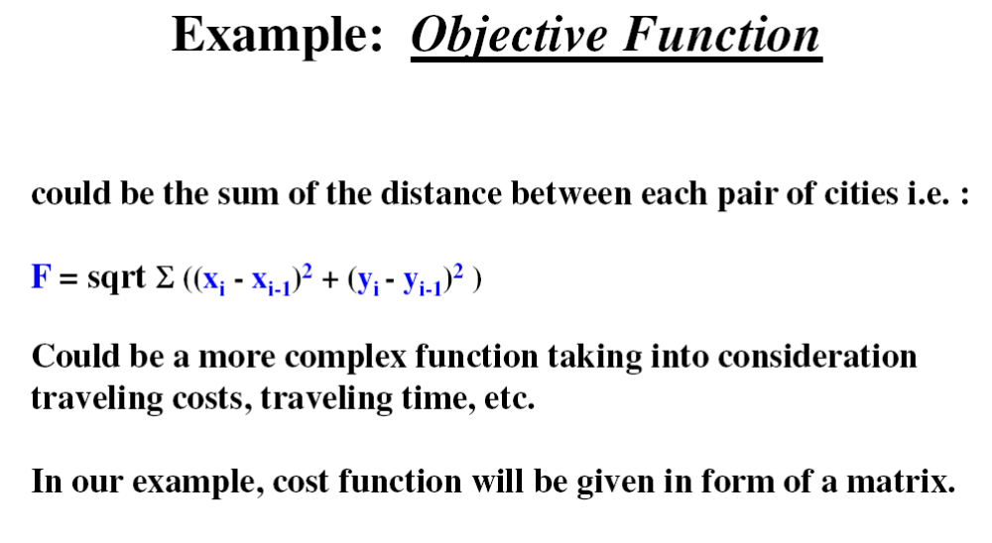

Slide 3
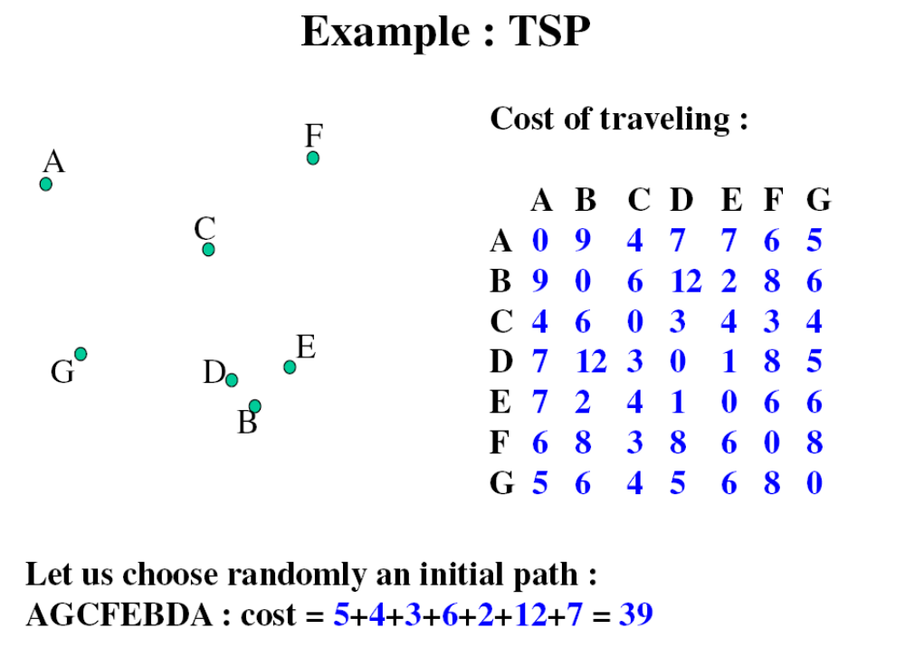

Slide 4
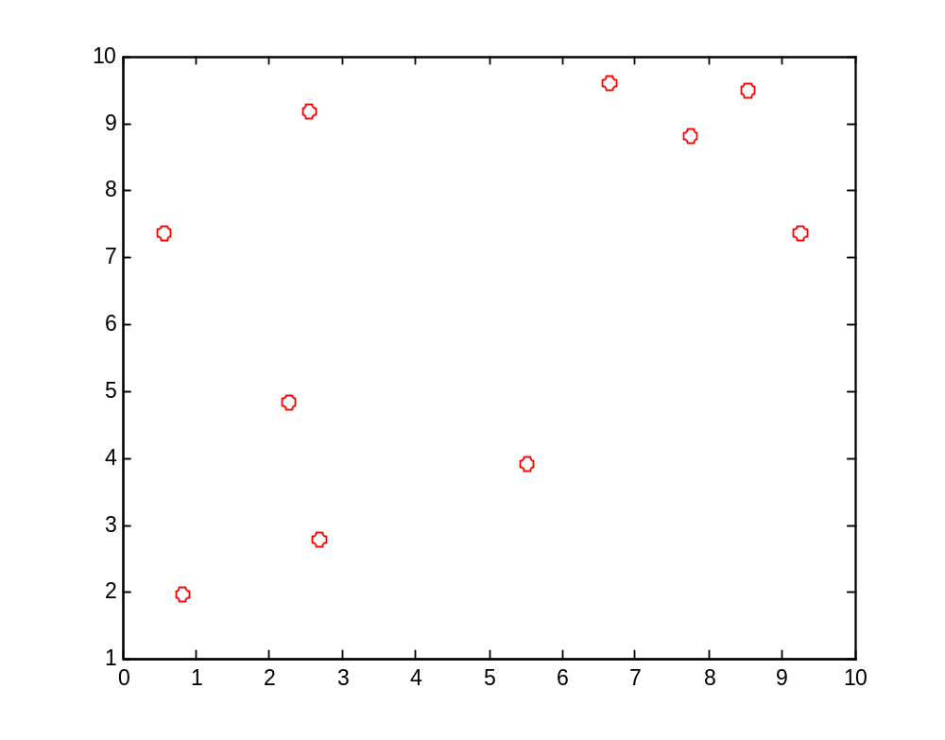
Data in Assignment I:
You have to solve three TSP problem with 10, 30 and 50 cities.
Coordina_10 : coordinates for 10 cities (xi,yi)
Coordina_30: coordinates for 30 cities (xi,yi)
Coordina_50: coordinates for 50 cities (xi,yi)
For example Coordina_10:
2.5346 9.1670
0.5659 7.3454
2.2720 4.8172
0.8226 1.9721
7.7530 8.8111
5.5220 3.8949
2.6775 2.7794
9.2573 7.3441
6.6485 9.5929
8.5379 9.4993

Slide 5
Create Cost Matrix:
0 2.6822 4.3577 7.3958 5.2305 6.0597 6.3892 6.9655 4.1359 6.0125
2.6822 0 3.0500 5.3794 7.3350 6.0389 5.0306 8.6914 6.4845 8.2578
4.3577 3.0500 0 3.1930 6.7818 3.3783 2.0778 7.4283 6.4777 7.8220
7.3958 5.3794 3.1930 0 9.7367 5.0776 2.0230 10.0001 9.5926 10.7789
5.2305 7.3350 6.7818 9.7367 0 5.3987 7.8830 2.1012 1.3532 1.0439
6.0597 6.0389 3.3783 5.0776 5.3987 0 3.0554 5.0842 5.8083 6.3644
6.3892 5.0306 2.0778 2.0230 7.8830 3.0554 0 8.0081 7.8862 8.9164
6.9655 8.6914 7.4283 10.0001 2.1012 5.0842 8.0081 0 3.4443 2.2721
4.1359 6.4845 6.4777 9.5926 1.3532 5.8083 7.8862 3.4443 0 1.8917
6.0125 8.2578 7.8220 10.7789 1.0439 6.3644 8.9164 2.2721 1.8917 0
Sample solution:
route =
3 7 8 5 1 2 4 9 10
Objective function Value:
long =
40.3418

Slide 6
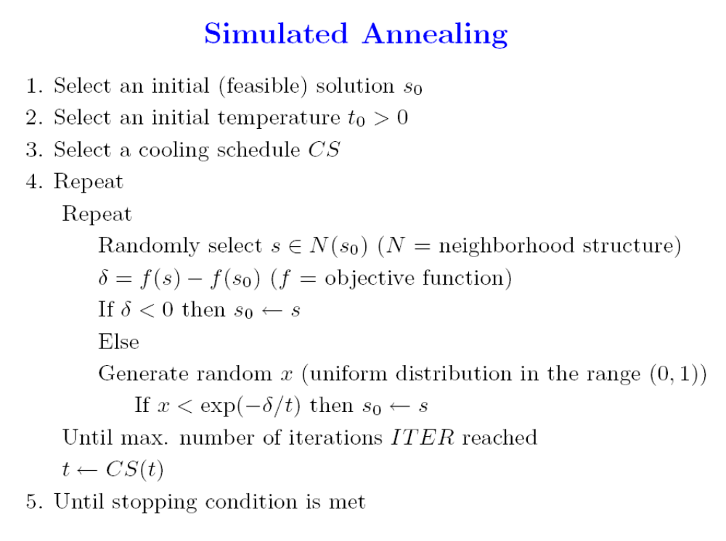
3 7 8 5 1 2 4 9 10
6 10 9 4 2 1 5 8 7 3

Slide 7
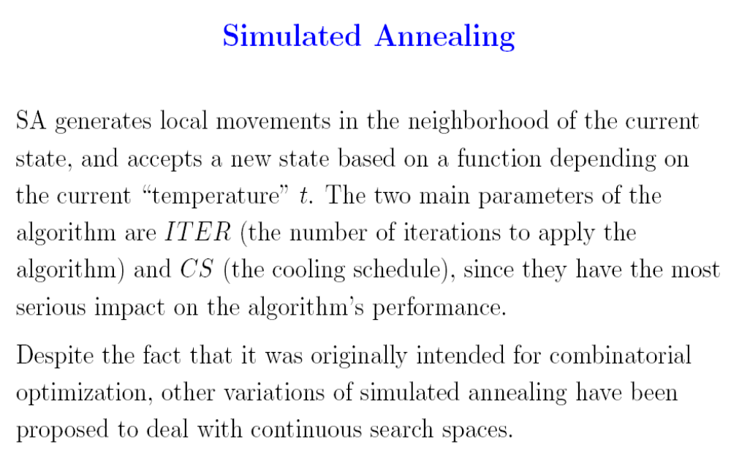

Slide 8
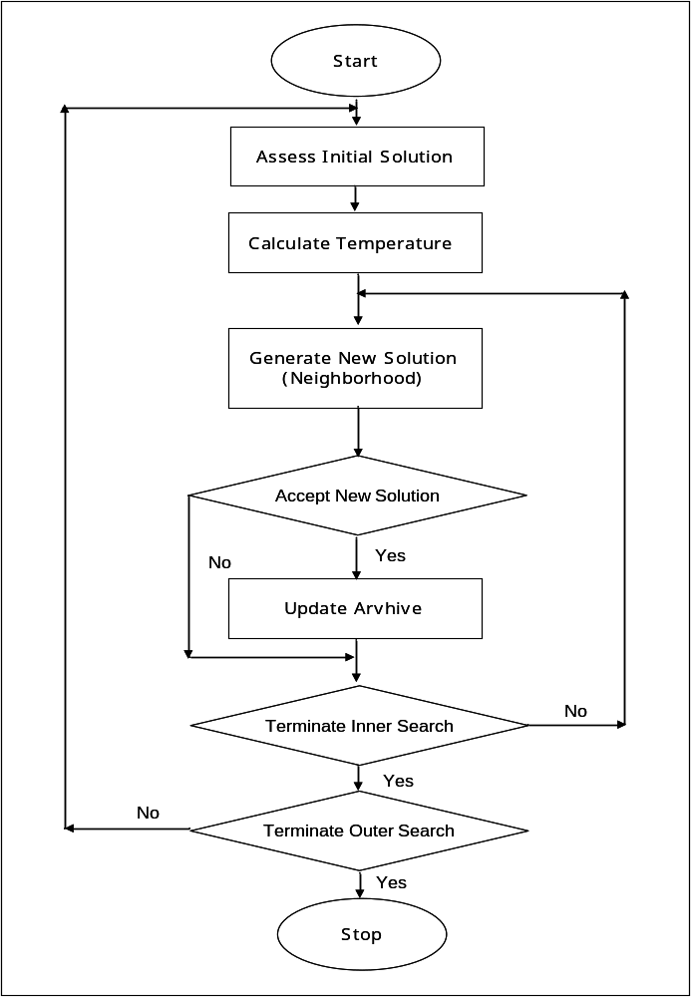
Update archive

Slide 9
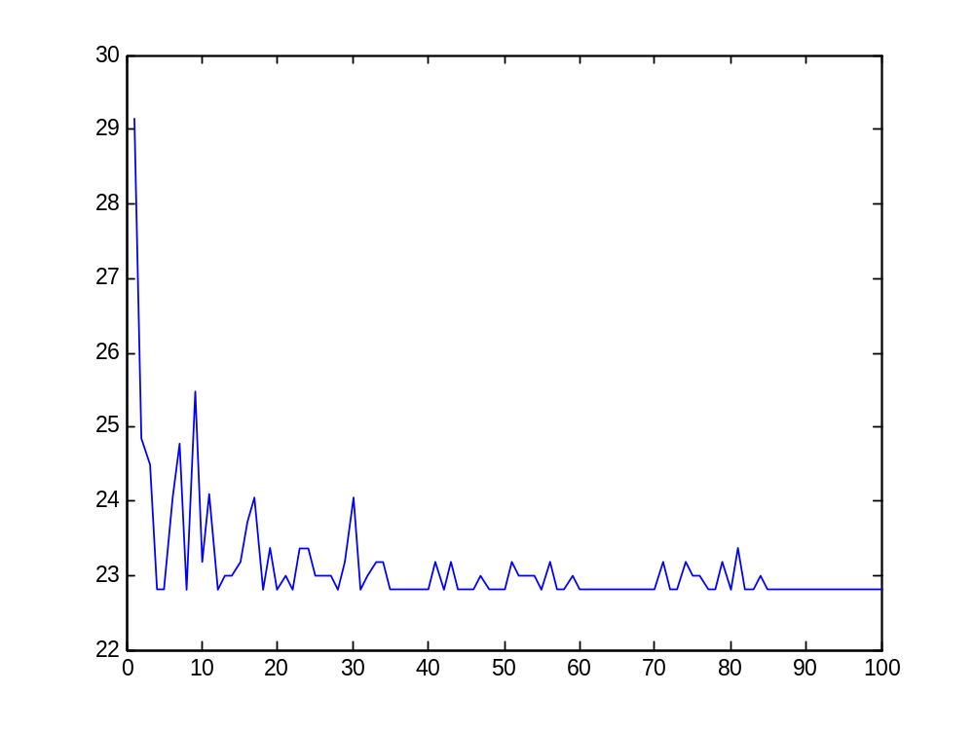
Search for 10 Cities

Slide 10
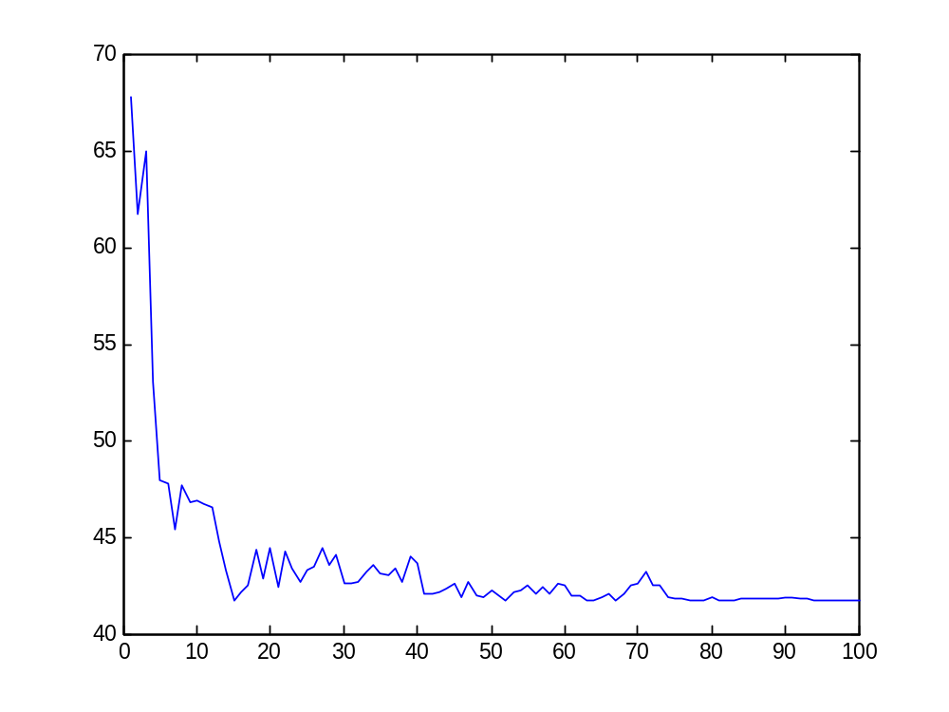
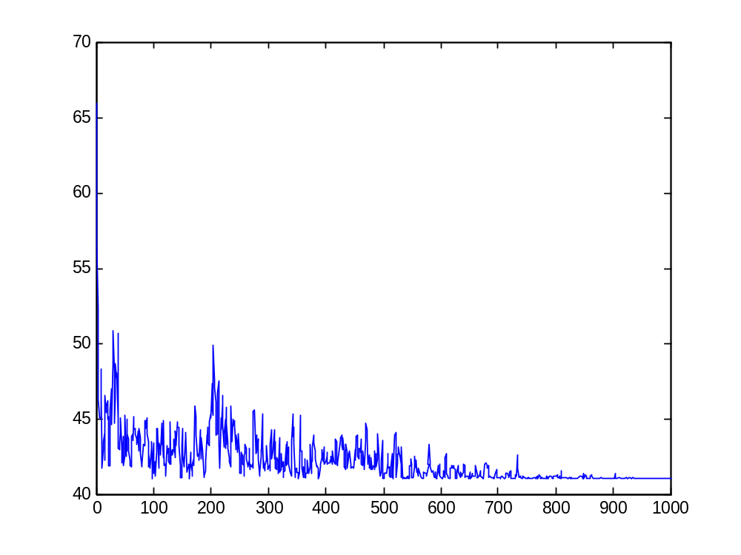
Search for 30 Cities

Slide 11
Multi-Objective Simulated Annealing

Slide 12
Update Nondominated Set
Update archive
Update Nondominated Set

Slide 13
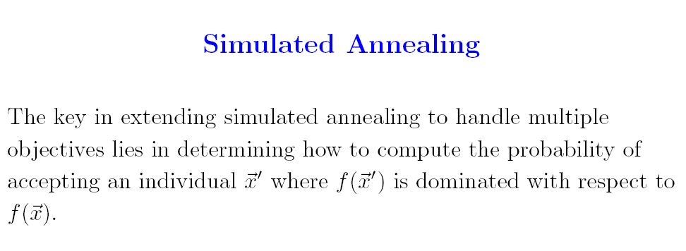
Multi-Objective

Slide 14
Sanghamitra Bandyopadhyay, Sriparna Saha, Ujjwal Maulik and Kalyanmoy Deb. A Simulated Annealing Based Multi-objective Optimization Algorithm: AMOSA , IEEE Transactions on Evolutionary Computation, Volume 12, No. 3, JUNE 2008, Pages 269-283.

Slide 15
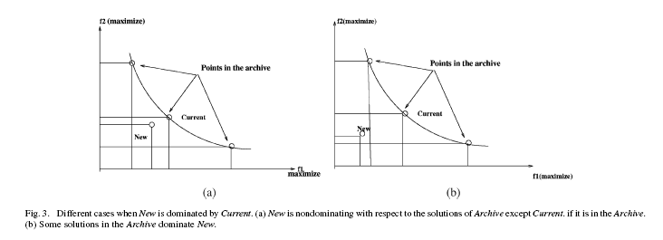
Case 1:

Slide 16
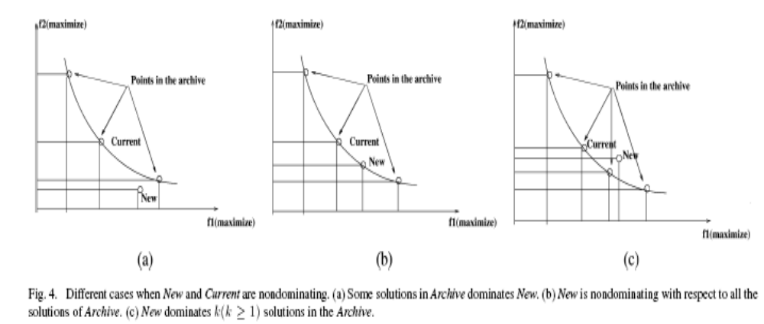
Case 2:

Slide 17
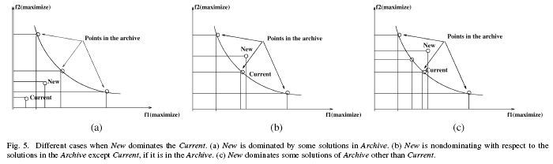
Case 3:

Slide 18
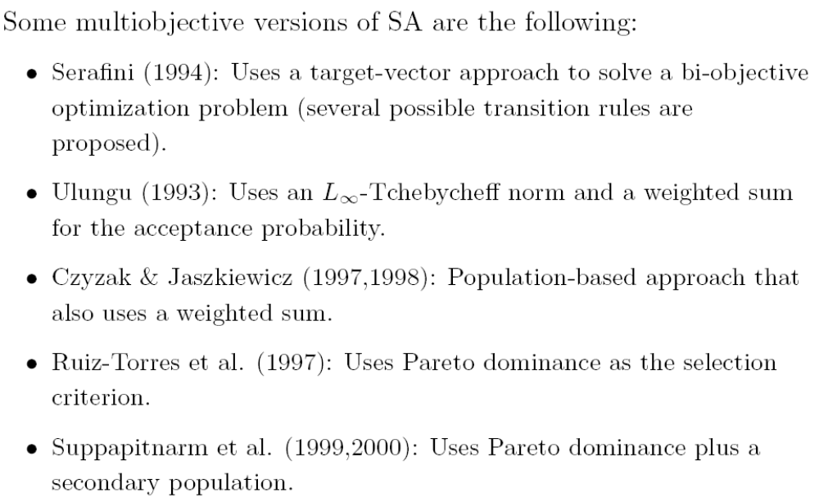

Slide 19




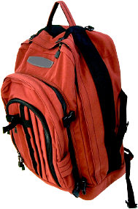
The 0-1 Knapsack Problem
weight = 750g
profit = 5
weight = 1500g
profit = 8
weight = 300g
profit = 7
weight = 1000g
profit = 3
?
Goal: choose subset that
maximizes overall profit
minimizes total weight

Slide 20
Update Nondominated Set
Update archive
Update Nondominated Set

Slide 21
The Solution Space
profit
20
15
10
5
weight
500g
1000g
1500g
2000g
2500g
3000g
3500g

Slide 22
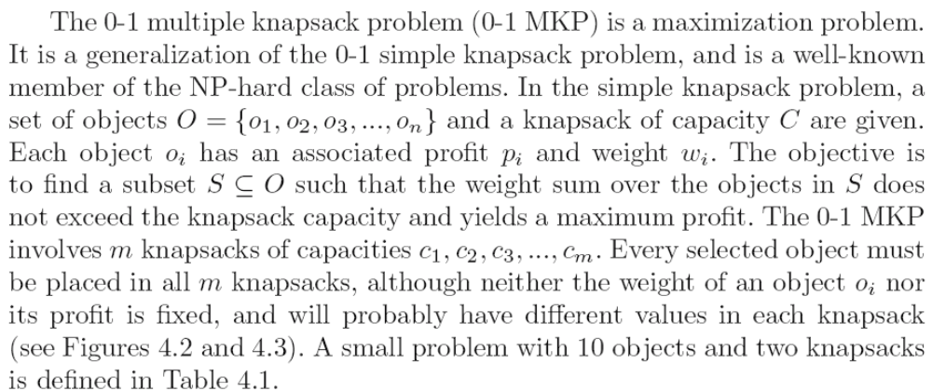
The 0-1 Multiple Knapsack Problem

Slide 23
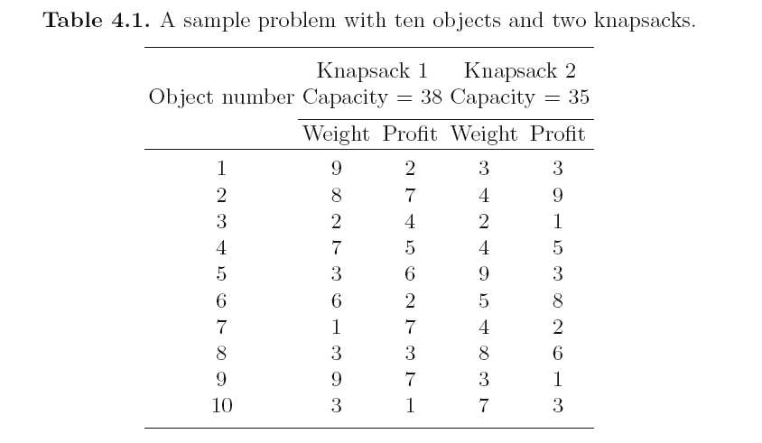

Slide 24
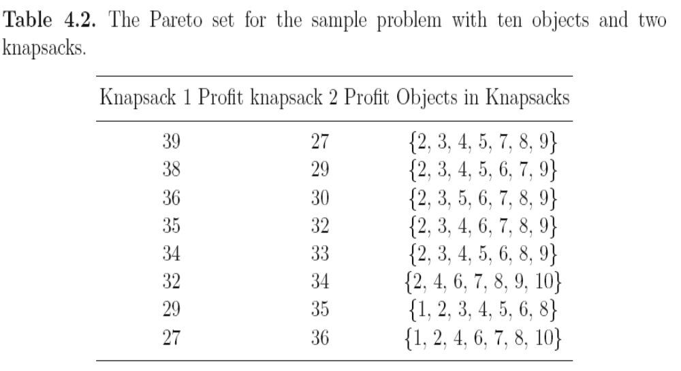

Slide 25
Domination
For any two solutions x¹ and x²
x¹ is said to dominate x² if these conditions hold:
  x¹ is not worse than x² in all objectives.
  x¹ is strictly better than x² in at least one objective.
If one of the above conditions does not hold x¹ does not dominate x².

Slide 26
Examples for minimization
Candidate | f₁ | f₂ | f₃ | f₄
1 | 5 | 6 | 3 | 10
2 | 4 | 6 | 3 | 10
3 | 5 | 5 | 2 | 11
4 | 5 | 6 | 2 | 10
5 | 4 | 5 | 3 | 9
(dominated by: 2,4,5)
(dominated by: 5)
(non-dominated)
(non-dominated)
(non-dominated)

Slide 27
Dominance
we say x dominates y if it is at least as good on all criteria and better on at least one
f₁
Pareto front
x
Dominated by x
f₂

Slide 28
Pareto Optimal Set
Non-dominated set: the set of all solutions which are not dominated by any other solution in the sampled search space.
Global Pareto optimal set: there exist no other solution in the entire search space which dominates any member of the set.

